Slide 1
TQM Models applied to SMEs
Dr. Sainis Georgios
DR. THANOS KRIEMADIS

Slide 2
Sourse:Price & Chen, 1993)

Slide 3
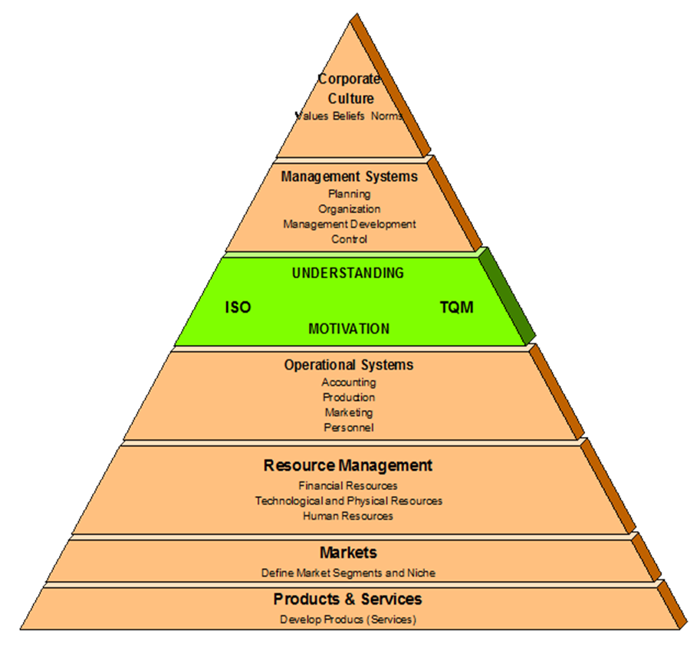
Source: Meegan, 1997

Slide 4
The Pincer model
Source: Karafet et.al, 2001)

Slide 5
The S-P Model
Source: Saunders & Preston, 2006)

Slide 6
Benefits derived
Supplier
Operational performance / Reduce waste
Improve processes/ Bring new partnerships
Employees
Team work/ More trust/ Increase morale
Bring job security/ higher compensation
Shareholders
Organizational performance / higher profits
Better understanding / greater accountability
Customers
Waste reduction / Reasonable prices
Customer satisfaction / Better trust and feel of partnership
Customer satisfaction/ Greater product & Service acceptance
Society/ Community
Waste reduction/ reduce global waste
More trust/ Trust becomes a core value
Operational performance / higher standard of living in the society

Slide 7
Thank you

